Slide 1
Geometric Design Sprint
Andrew Green
ENGR112-0001
2/27/22
In accordance with JMU honor code policy.

Slide 2
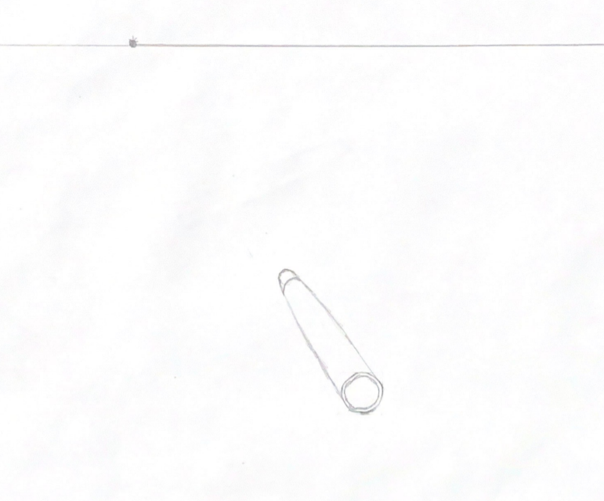
Pen Body, One Perspective
This was the first part of my object I tried to draw. I found it to be a unique challenge due to never having drawn cylinders before in this style, and then never having drawn cylinders with decreasing radius in this style.

Slide 3
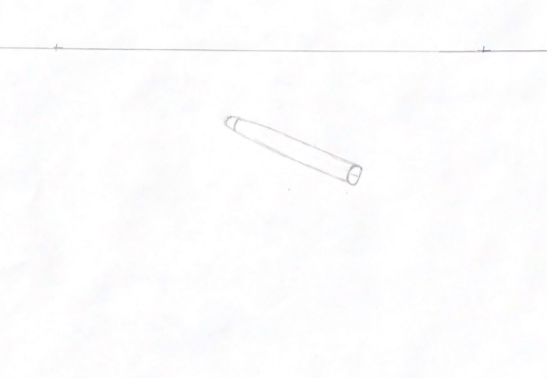
Pen Body, Two Perspectives
The two perspective drawing proved to be even more of a challenge than the single perspective for this part. I found it difficult to show the object shrinking towards both vanishing points due to it’s long and slender nature, as well as not being confident on my approach to hand drawing cylinders.

Slide 4
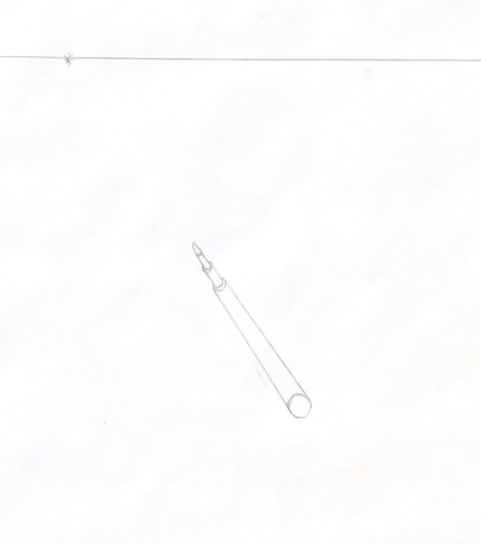
Ink Tube, One Perspective
This was one of the simplest parts of my object, and as a result, I feel that these drawings gave me a much needed confidence boost. Given that it consisted solely of cylinders, that didn’t change radius along their length, I was able to experiment with and better understand the best approach to drawing the rest of my parts.

Slide 5
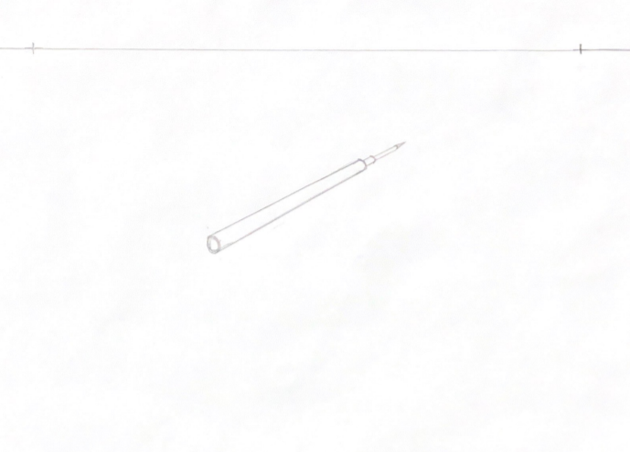
Ink Tube, Two Perspectives
While I struggled with showing the double vanishing points on the first object, I think I showed it quite well for this one. Getting the cylinders to shrink towards both vanishing points took a lot of thought and readjustments, but I am very pleased with the results.

Slide 6
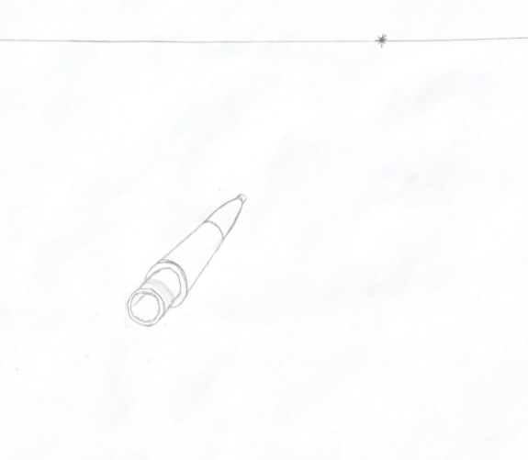
Pen Tip, One Perspective
This was ultimately my most difficult part to draw. The method I used for earlier parts, drawing a rectangular prism around the cylinders, and using that easier shape to show the shrinking towards the vanishing point, was a bad fit for an object with sections larger than the initial face. I plan to revisit this in the future to learn a better approach.

Slide 7
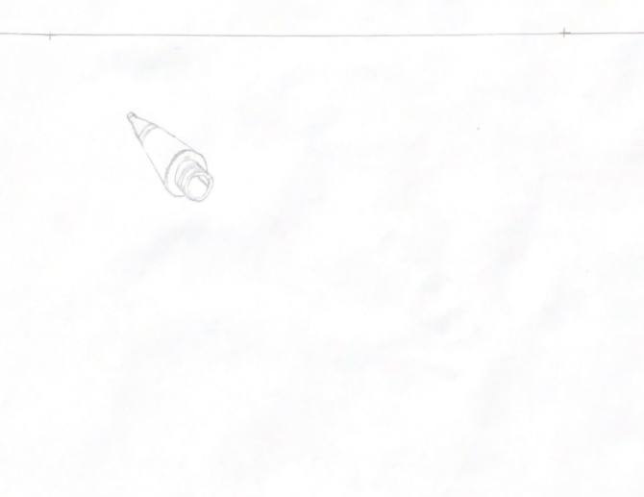
Pen Tip, Two Perspectives
This drawing shows my earlier method suffering even more. Due to the cone like shape, it was very difficult for me to also show the object shrinking as it approached the vanishing point. Showing the threads on the first section was also quite difficult, and I am not wholly satisfied with the result, or my knowledge of how to draw similar parts in the future.

Slide 8
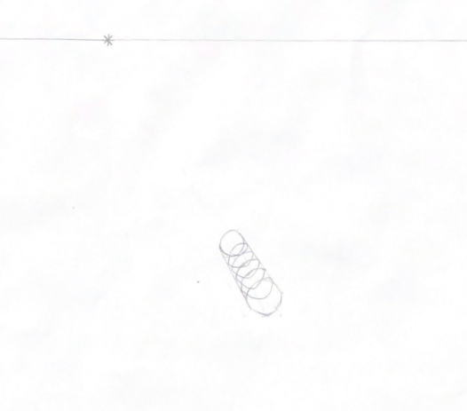
Pen Spring, One Perspective
This object was likely the second hardest for me to draw. My earlier method worked great for the start and the end of the spring but left me clueless as to how to draw the coils. After a long while of staring at springs, I believe my drawing is at least an ok approximation of what they look like, but this is another area where I definitely need more practice.

Slide 9
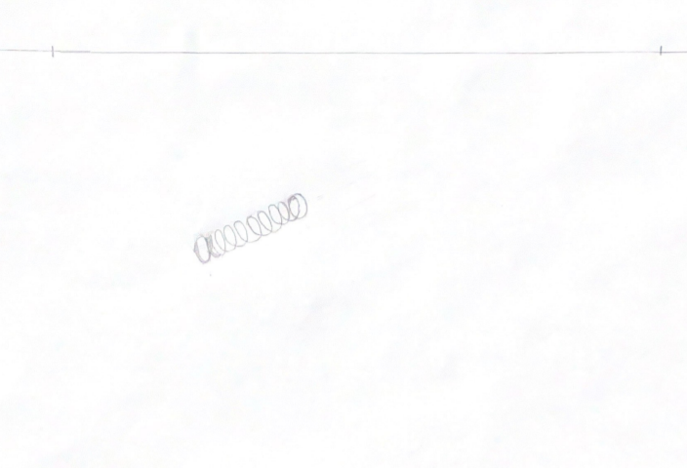
Pen Spring, Two Perspectives
Before this assignment, I never would have considered how difficult springs are to draw, especially in multiple perspectives. If you look at it just right, I think it looks correct, but better line weight, shading, or a completely new approach is needed to turn this drawing of a spring into one that consistently looks like a spring.

Slide 10
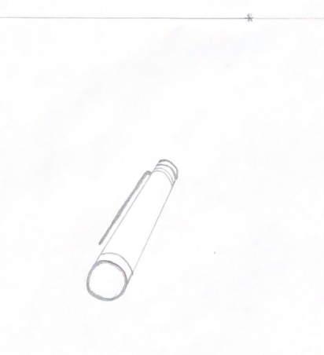
Pen Cap, One Perspective
Creating this drawing was relatively simple, with the earlier approach of using a rectangular prism around the cylinder working well, with the only point of pause being the offshoot for the clip and showing it in perspective. I felt pretty good about the improvements in drawing ability this project had given me by this fifth object.

Slide 11
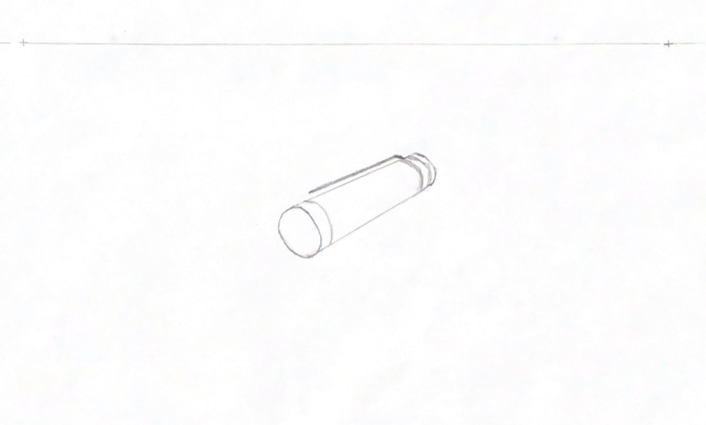
Pen Cap, Two Perspectives
Similar to the ink tube drawings, this component was simple, with no cones or otherwise complex shapes, and I feel it turned out well. Showing the clip was again my only point of hesitation but I am proud of how the rest of it turned out.

Slide 12
Hand Drawings Reflection
My selection process for the parts I drew was quite simple, as I picked an object with exactly five parts. I picked the object simply because it was close at hand and on the surface seemed like it would be straightforward to recreate. As I was creating the 10 drawings, I attempted to approach each of them slightly differently. This was more difficult with the single perspectives, as it was hard to create variation, but I changed the angle to and distance from the vanishing point for each one, to force myself to think about each object slightly differently instead of all the same. For the two perspective drawings, I not only changed angle and distance from the vanishing points, but also the orientation of the objects, so that they appeared to be facing different directions, again making each one a unique process. I believe that this shows that I wanted to learn and practice more advanced skills surrounding perspective drawings, rather than two skills, five times.

Slide 13
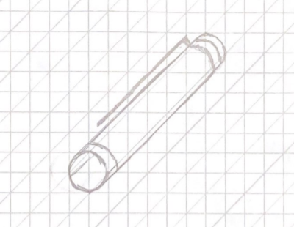
Pen Cap, Oblique
This was the first oblique drawing I did, and I went about it in the same method we did in class, with very little experimentation. This caused it to be technically correct, but I did not learn much from making it.

Slide 14
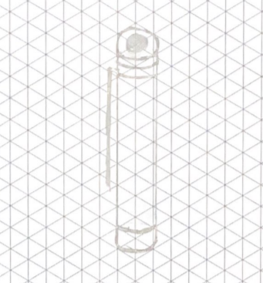
Pen Cap, Isometric
I again did not push many boundaries with this drawing, making it relatively simple to complete. The only parts that were difficult were the clip and keeping the rings on the body of the cylinder concentric with the circle or the arc on the top and bottom.

Slide 15
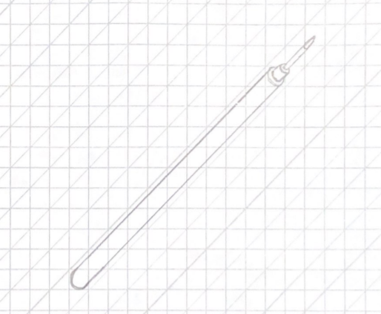
Ink Tube, Oblique
While I’m not sure if this drawing is correctly done as an oblique, I experimented with using a face other than the very end of the object as the start of my drawing, and I think the flipped look that it provides is interesting.

Slide 16
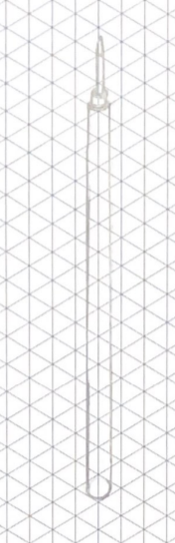
Ink Tube, Isometric
The isometric drawing for the ink tube was one that I thought would be easy to complete quickly, but I found that it was quite difficult to maintain the isometric view and keep the smaller and smaller circles concentric of one another.

Slide 17
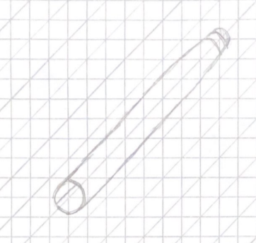
Pen Body, Oblique
Drawing the body of the pen again was no easier in an oblique style than it had been for the one and two perspective drawings. I found that the gentle curve was very hard to mimic, and the angle of the oblique style made it difficult to keep it looking symmetric around its center.

Slide 18
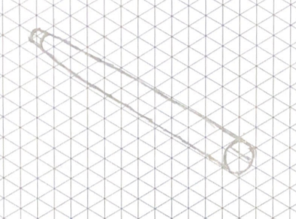
Pen Body, Isometric
I took a different approach to this isometric drawing. After drawing the other two components in an upright or vertical orientation, I decided to do this drawing in a horizontal orientation. I feel that this drawing shows the curve on the pen body best, but I plan to keep practicing my hand drawings so that I can more consistently get results closer to this.

Slide 19
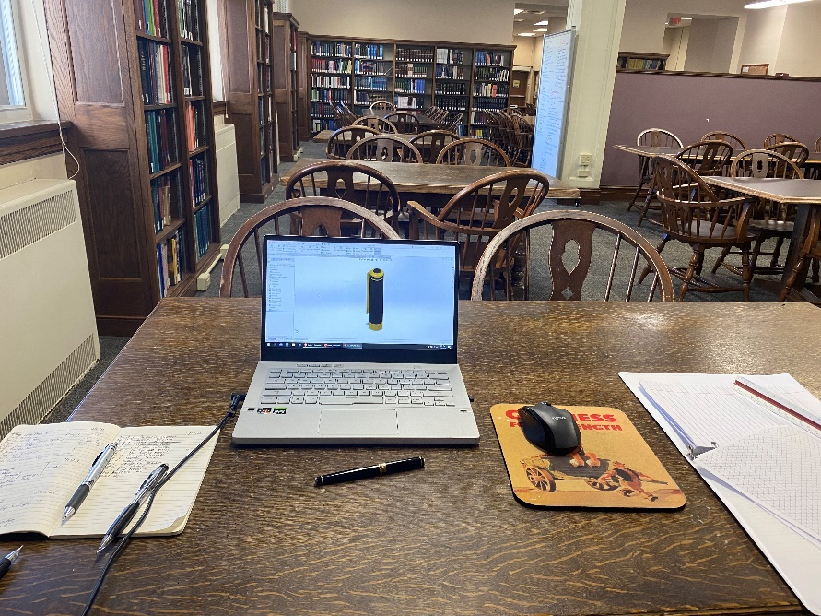
Perspective Reflection
I have worked on this project in many areas, but the quiet area of the library is where I have gotten most work done. I believe this is because it is quiet, it’s usually not crowded, and none of the objects in the surrounding area are interesting to me. I personally have no improvements I’d make to this area, only improvements to my habits, as I waste time trying to work in areas where I get distracted easily and slack off, when I know I am productive here.

Slide 20
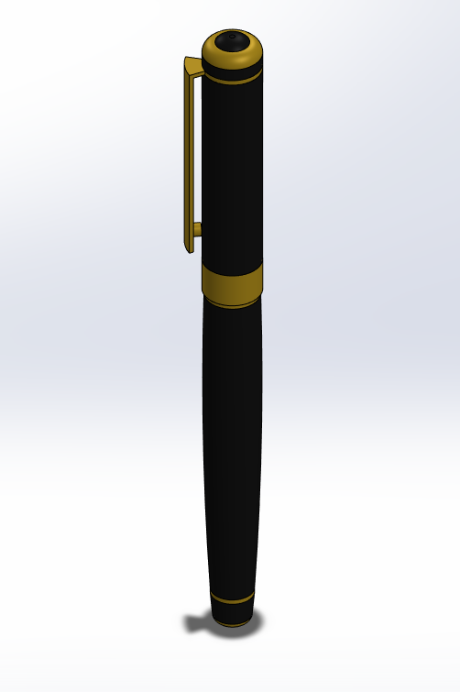
Assembly Model
The culmination of many hours of work, I set the material appearances to be as close to life as I could, though I sincerely doubt this cheap pen from Amazon is made of brass. I had issues when it came to constraining this, as many of the parts don’t fit together perfectly in the object.

Slide 21
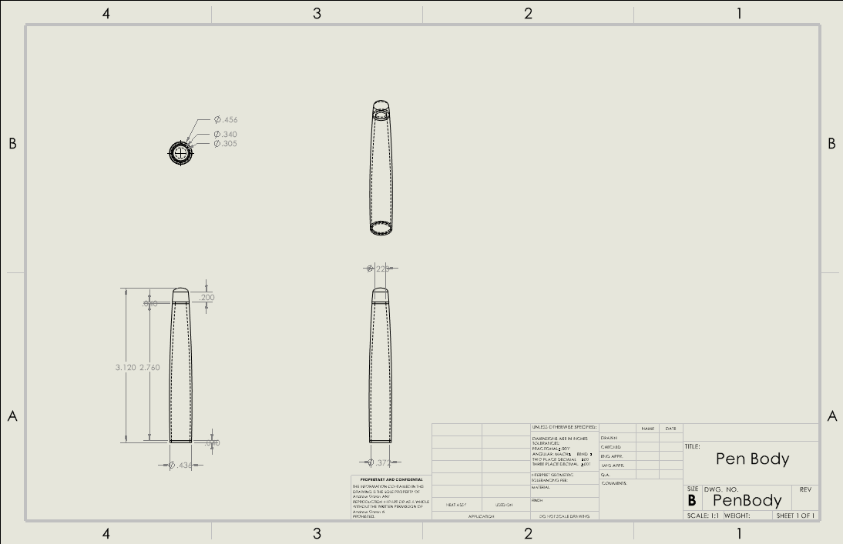
Pen Body, Orthographic

Slide 22
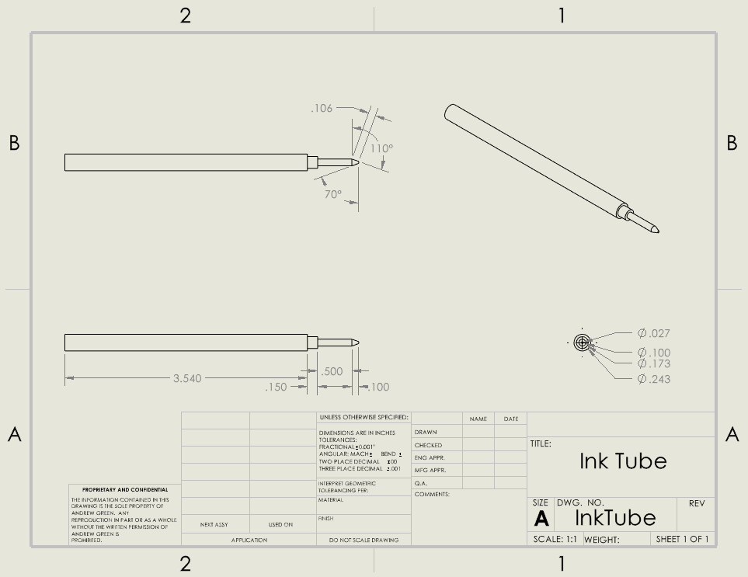
Ink Tube, Orthographic

Slide 23
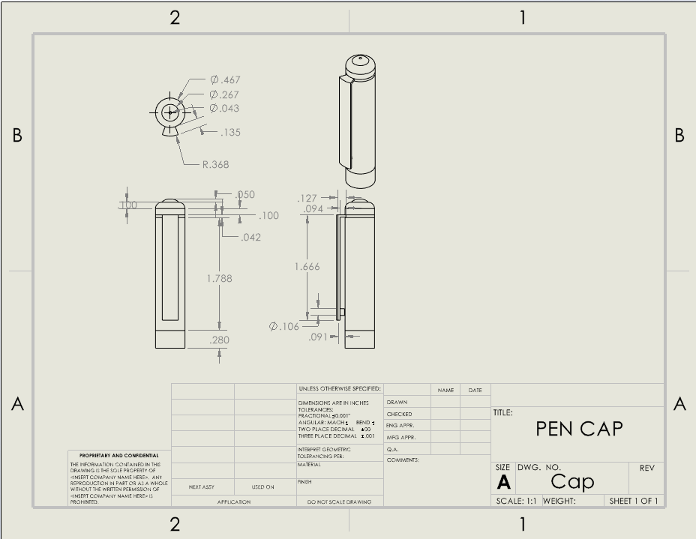
Pen Cap, Orthographic

Slide 24
Orthographic Reflection
After pausing and reflecting on my orthographic drawings, everything looks to be in order. The only possible issue I see is that due to one of the curves being a spline, it is hard to properly dimension, but I have all the supporting dimensions for it in place.

Slide 25
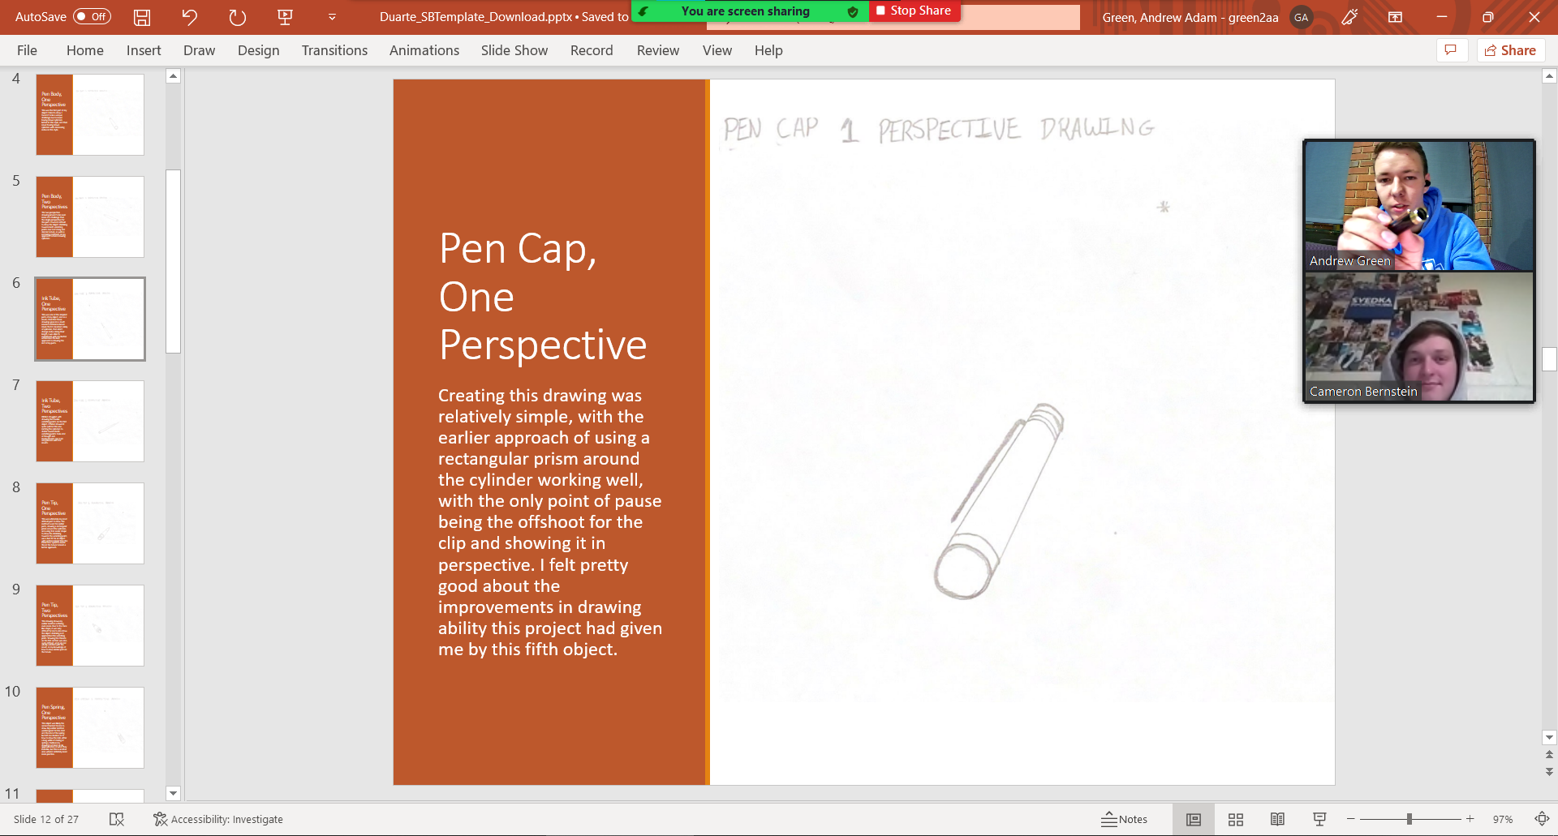
Peer Feedback
I worked with Cameron to get feedback on my drawings. One of the biggest changes he suggested was adding a horizon line to my sketches, which is a very important change that I have since implemented. Additionally, he suggested making sure that my drawing sheets from Solidworks were all set to IPS, which I promptly fixed.

Slide 26
Final Reflection
Almost everything about my drawings and the 3D models I made of them appears to be sport on. I’m super happy with the transition between the one perspective sketches and the completed models. I think my growth through this semester has been very significant. I’ve gotten much more confident with drawing, I follow better practices with my 3D modeling, and I’m getting much better at preparing presentations. I’ve had to transition from Autodesk Inventor to Solidworks and this class has made it pretty easy. I hope to keep honing my development skills and eventually be able to work at a high functioning, professional level. I hope to make friends in my cohort as well as all around me, and generally enjoy college as I grow in my knowledge, skills, and network.

